Slide 1
ONLINE ENROLLMENT

Slide 2
HOW TO JOIN CTA
Enrollment Form
Traditional paper form for Certificated, CCA or ESP. This is printed and distributed annually to Locals.
Fillable PDF
Fillable PDF of the current paper enrollment form for Certificated, CCA or ESP. Districts may include in any electronic on-boarding materials to new hires.
CTA 360 Mobile App
Certificated and CCA Local leaders, who have face-to-face contact with members, may enroll them directly on the Leader’s Mobile App with the member’s electronic signature.
Join.CTA.Org
Online form available from www.CTA.org for individuals to enroll with CTA.

Slide 3
ONLINE ENROLLMENTS
New individuals (not currently found in Falcon)
They will have the ability to create a new Individual Profile and indicate which Local/Employer they work with.
Individuals coming back to CTA after a break (found in Falcon)
They will have the ability to add a new active membership with their new local/employer to their existing individual profile in Falcon.
Individuals moving districts (found in Falcon)
They will have the ability to add a new active membership with their new local/employer to their existing individual profile in Falcon.
Current Non-Members (found in Falcon)
They will have the ability to convert their Non-Member status to Active Member in their existing individual profile in Falcon
Current Student Members (found in Falcon)
They will have the ability to add a new active membership with their new local/employer to their existing individual profile in Falcon.

Slide 4
OTHER ENROLLMENT TYPES
Current Retired Members
Not allowed to enroll with a new local/employer online.
Current Active Members
Not allowed to enroll with their same local/employer online.
CCA Members & ESP Members
Online enrollment available at https://join.cta.org
Student Members
Online enrollment available at www.cta.org/for-educators/meet-cta/studentcta
Retired Members
Online enrollment available at www.cta.org/for-educators/meet-cta/retired

Slide 5
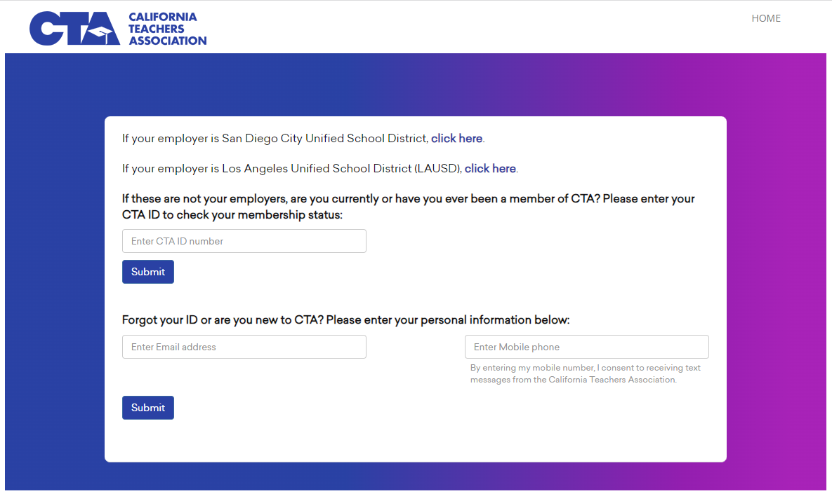
ONLINE ENROLLMENT
INITIAL SEARCH
Members are asked to enter their CTA ID, home email or cell phone number. This will allow the system to verify their eligibility and to also search the Falcon Database for any existing individual profile.

Slide 6
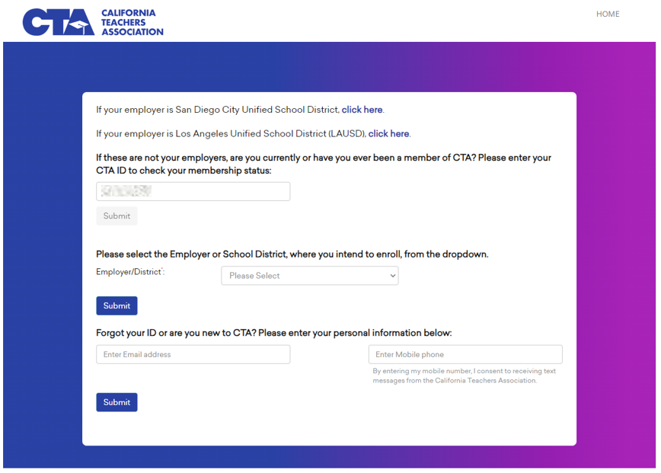
ONLINE ENROLLMENT EMPLOYER INFORMATION
If a member is found in the Falcon Database, they will then be asked to select the EMPLOYER they wish to enroll with. This will check their eligibility to enroll with the EMPLOYER selected.

Slide 7
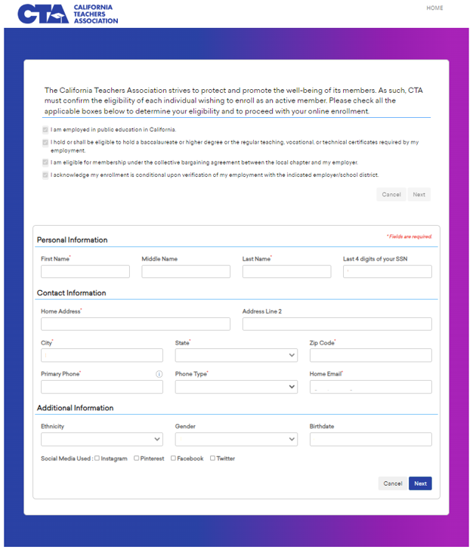
ONLINE ENROLLMENT 3 PAGE FORM Page 1: Individual contact information

Slide 8
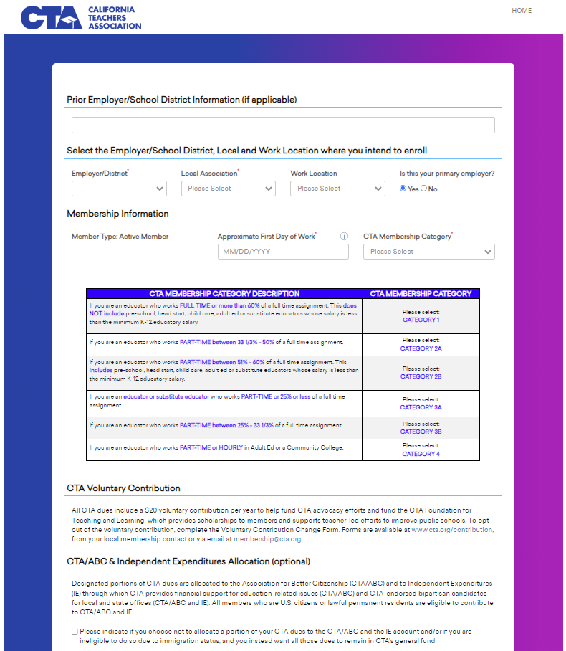
ONLINE ENROLLMENT 3 PAGE FORM Page 2: Membership information

Slide 9
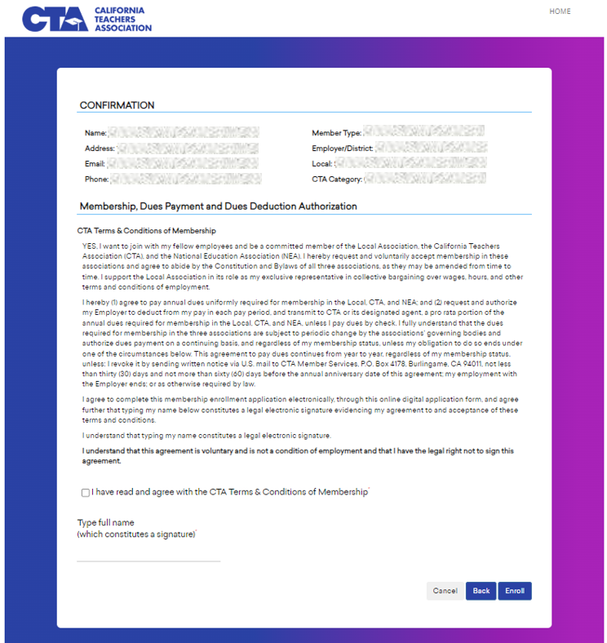
ONLINE ENROLLMENT 3 PAGE FORM Page 3: Confirmation and signature

Slide 10
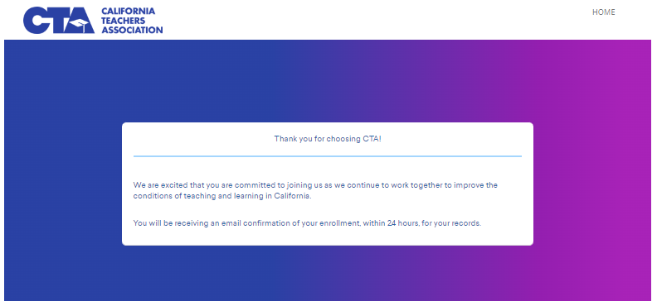
ONLINE ENROLLMENT CONFIRMATION Member will receive an on-screen confirmation

Slide 11
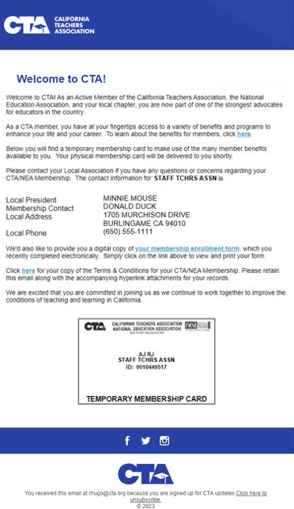
ONCE ENROLLMENT IS COMPLETE
Member will receive a “Welcome to CTA” email within 24 hours, which includes:
Welcome message
CTA Terms & Conditions
CTA Member Benefits Information
Link to digital membership enrollment form
Temporary CTA membership card

Slide 12
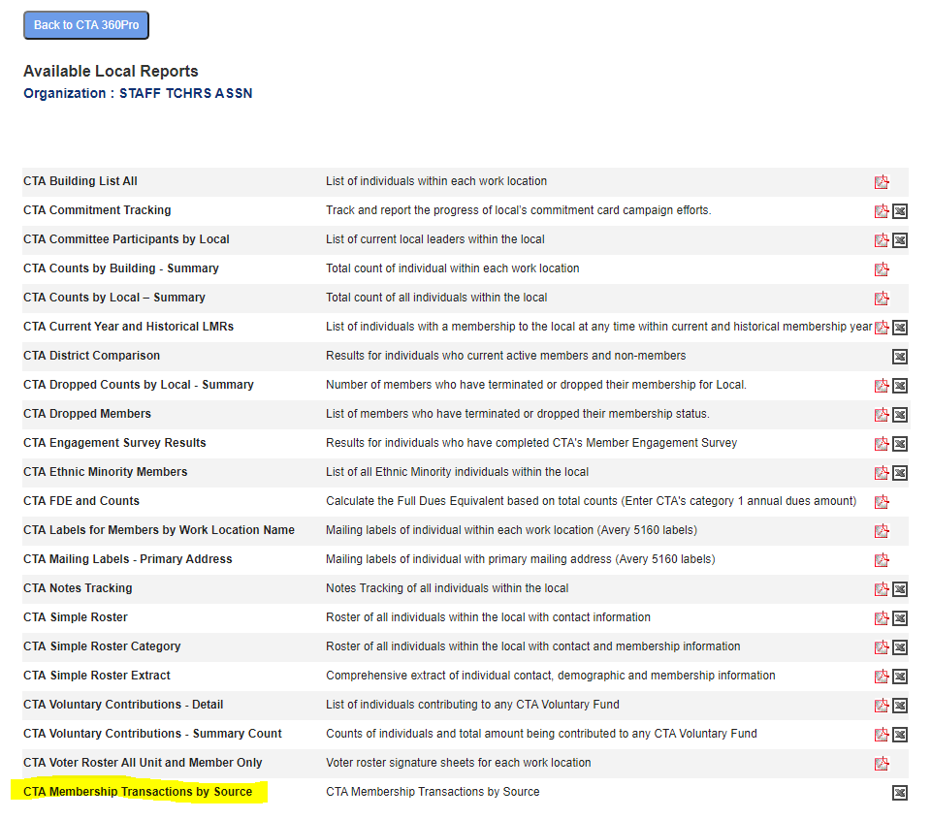
NOTIFICATION OF ENROLLMENTS
WEEKLY
CTA’s Membership Department will notify the following by email:
Local President
cc: The Local’s PCS
ON DEMAND
Local Leaders with access to CTA 360Pro may run a transaction report at any time. This report will show transactions for any day, prior to the current date.

